Slide 1
NL2SQL
Team 008:
Anjali Vemula (6076947), Akshat Dasula (5979761)

Slide 2
Introduction
Pain point: “Data is available, but not accessible.”
Data Access is usually through SQL, limited to technical experts
Non-technical users in domains like finance, rely on analyst to generate reports, delaying decisions.
With advancements in NLP and LLMs, people can directly talk to legacy systems
This bridges the gap between human intent and machine logic, unlocking data for everyone.
ChatGPT gives only “best guess” output

Slide 3
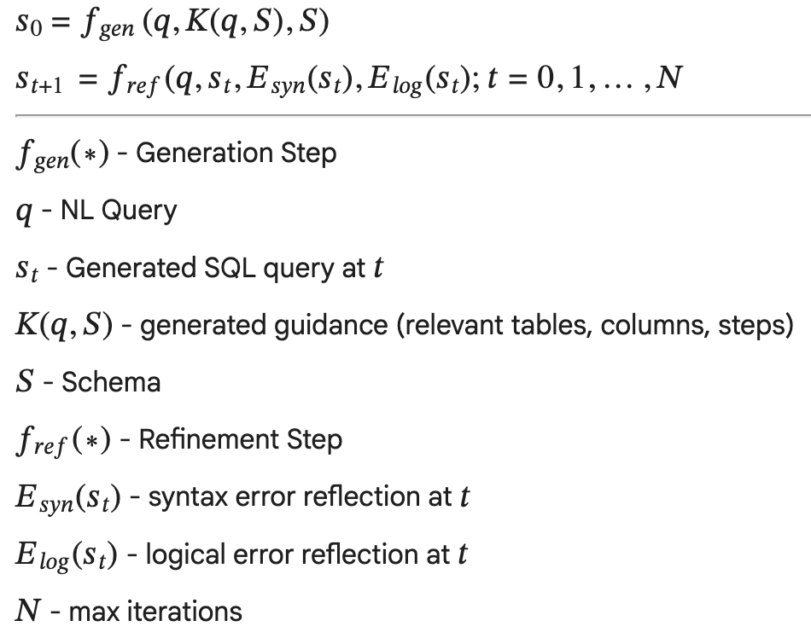
Problem Definition
It is necessary to have a automatic, reliable, safe solution to convert NL queries to SQL seamlessly
Users should be able to ask questions in plain English and receive correct, executable SQL without knowing the database structure
Challenge: LLMs often produce SQL that is syntactically invalid, uses wrong hallucinates tables or columns names, or does not match the user’s intent. Making it necessary for error-checks

Slide 4
Literature Review
Previous works have demonstrated use of specialized architectures such as [1] that take portions of NL and link SQL semantically
With the large number of LLMs today, it is necessary that we adopt good prompting strategies such as [2] and use evaluations such as [3].
Even with that SQL query is not easy to generate from NL query. [4] the base paper for our approach.
Our approach differs using persona based KPI-driven approach, by adding logical error analysis and feedback loops to correct the generate SQL query over iterations

Slide 5
Insurance Data
Relations in DB:
Policies – Contains details of issued insurance policies
Claims – Tracks claims filed against insurance policies
Agents – Stores information about agents selling or managing policies.
Submissions – Represents incoming insurance leads and quote processing
Customers - Stores customer demographic, financial, and preference information

Slide 6
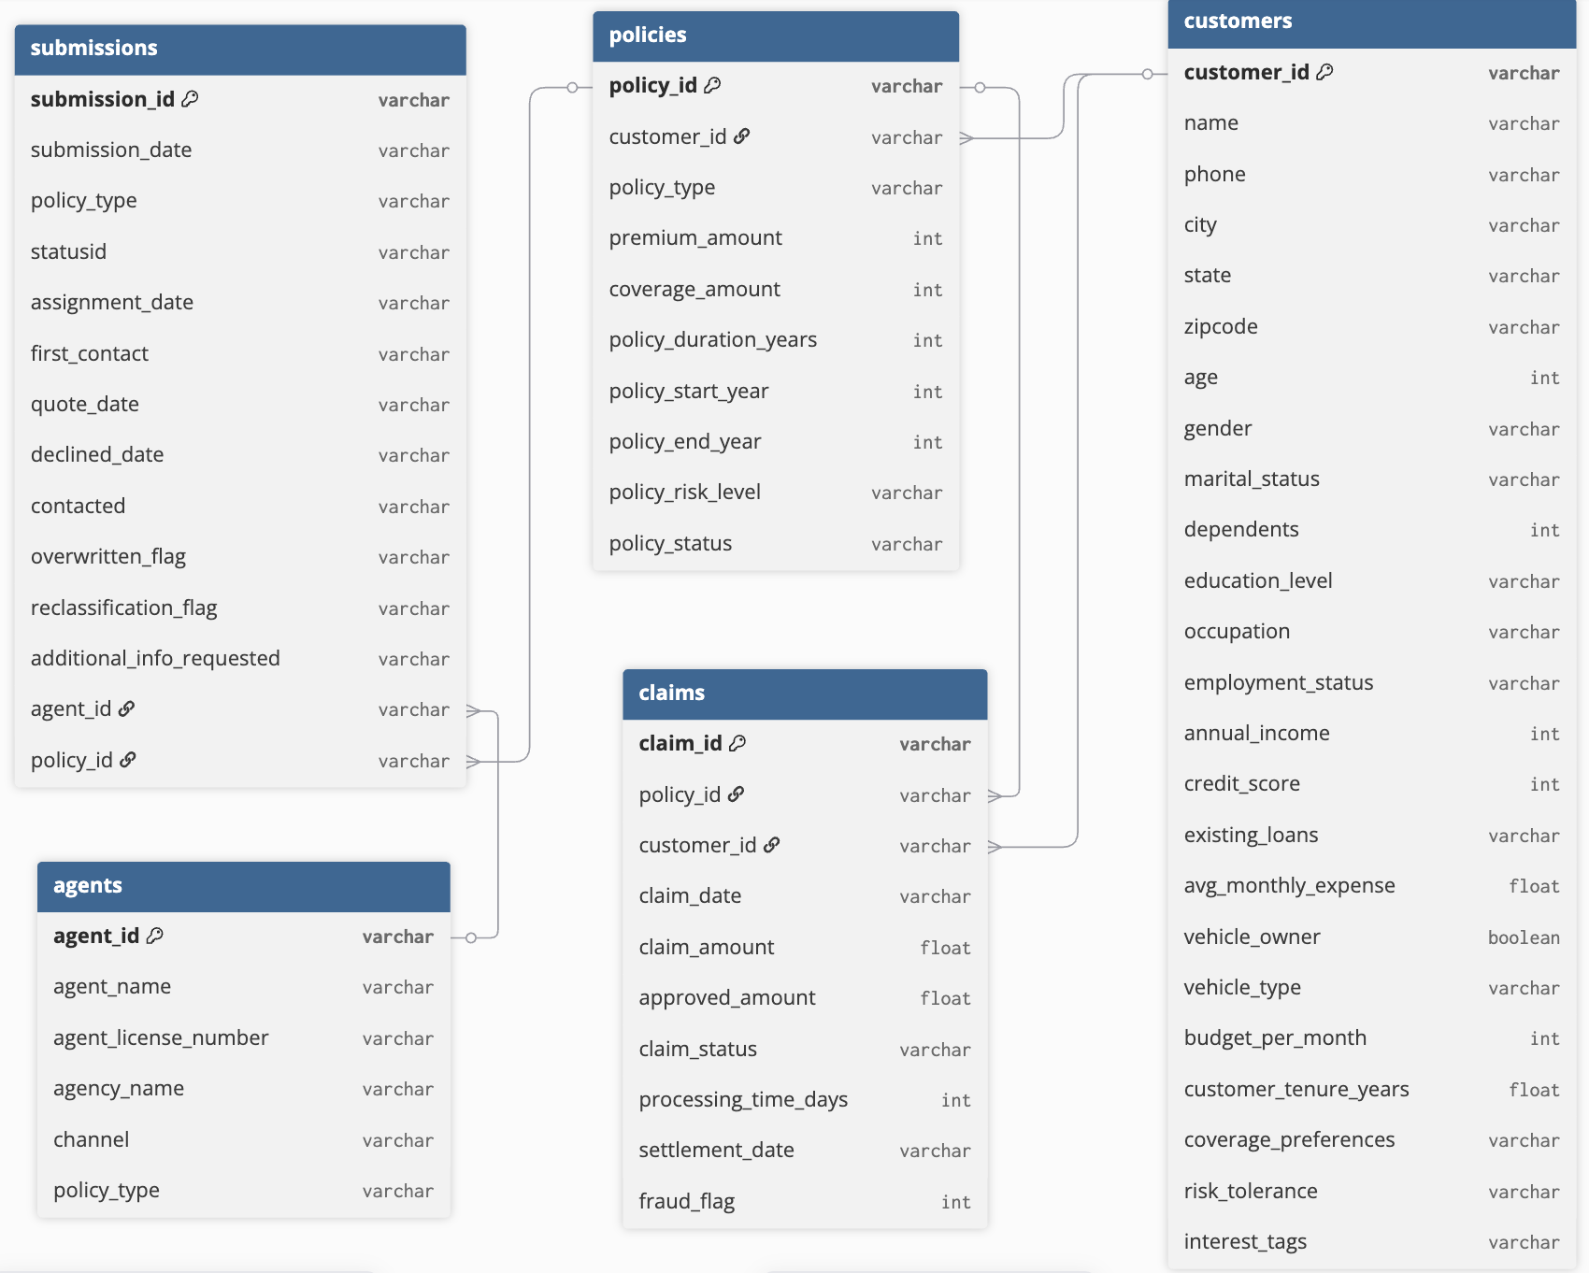
DB Diagram

Slide 7
Approach
User enters an NL Query:
Query is checked for relevance
Knowledge is generated for the query
This knowledge, schema, KPIs etc are used to generate the SQL query
SQL query is run on sqlite3 DB for syntax errors
Errors are caught and query is tuned
Query is run for logical errors via reverse engineering
Suggestions are taken and query is tuned
Repeated for N times, results are fetched

Slide 8
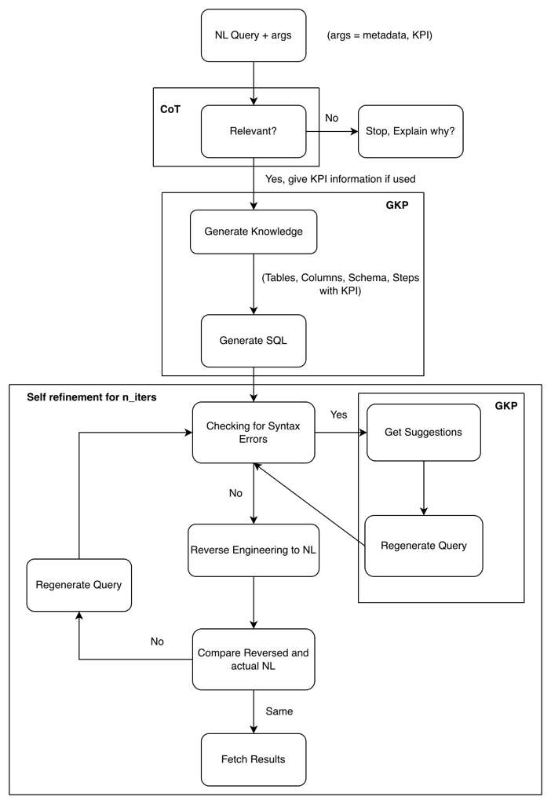
Flow of Execution
NL - Natural Language Query
KPI - Key Performance Indicators
CoT - Chain-of-Thought
GKP - Generate Knowledge Prompting

Slide 9
Query Generation: Checking relevance
When an NL query is given:
First the relevance of that query is checked (to the domain):
For query: “What is the loss ratio in 2023, 2024?”
Relevance Explanation: “The query asks for the loss ratio, which is a direct reference to a KPI in the insurance domain”
For query: “What is the cost of this swimming pool?”
Relevance Explanation: “The query asks for the cost of a swimming pool which does not relate to the insurance doman.

Slide 10
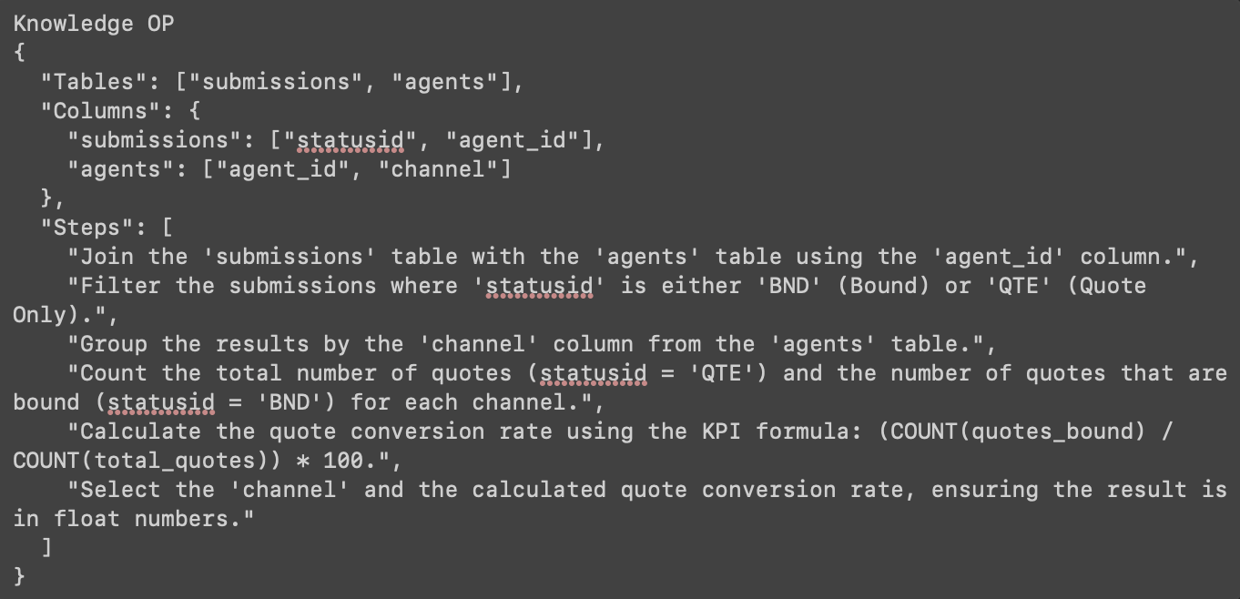
Query Generation: Generating SQL
If the given SQL query is relevant:
First related knowledge is generated, this knowledge contains:
Tables, Columns to use
KPI formula if used in NL
Steps to generate the query
Finally, this information is used to generate the SQL query

Slide 11
Query Execution: Checking for Syntax Errors
The generated query is then run on an sqlite3 DB.
If the executed, it is continued for next steps:
Otherwise,
Suggestions are asked for revisions of the generated query
These suggestions are used to generate and execute the query again.

Slide 12
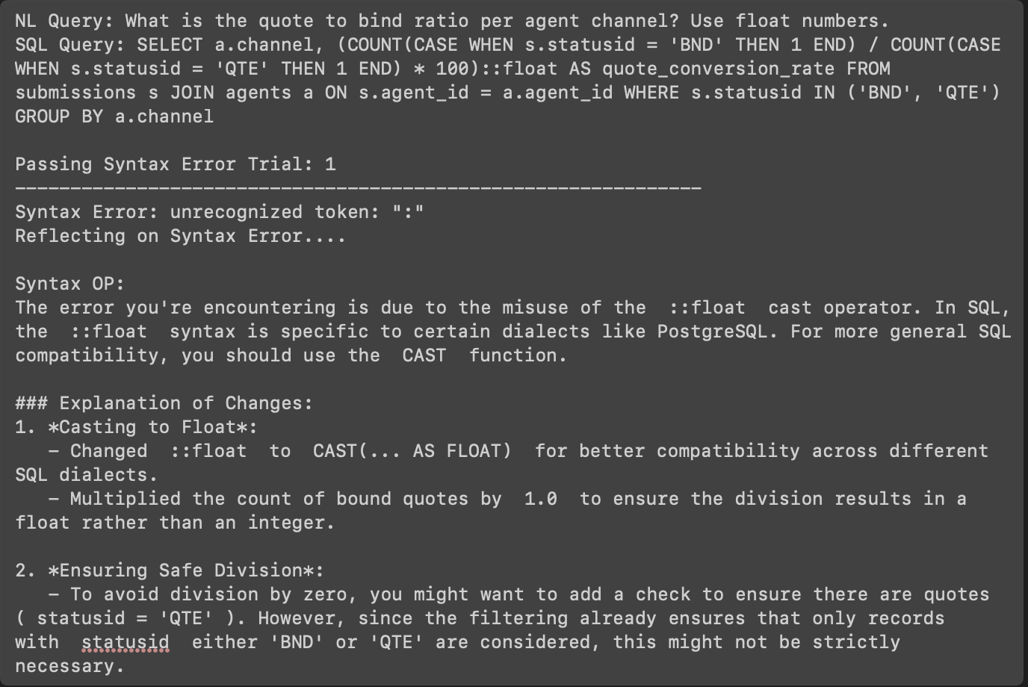
Query Execution: Example of Syntax Error

Slide 13
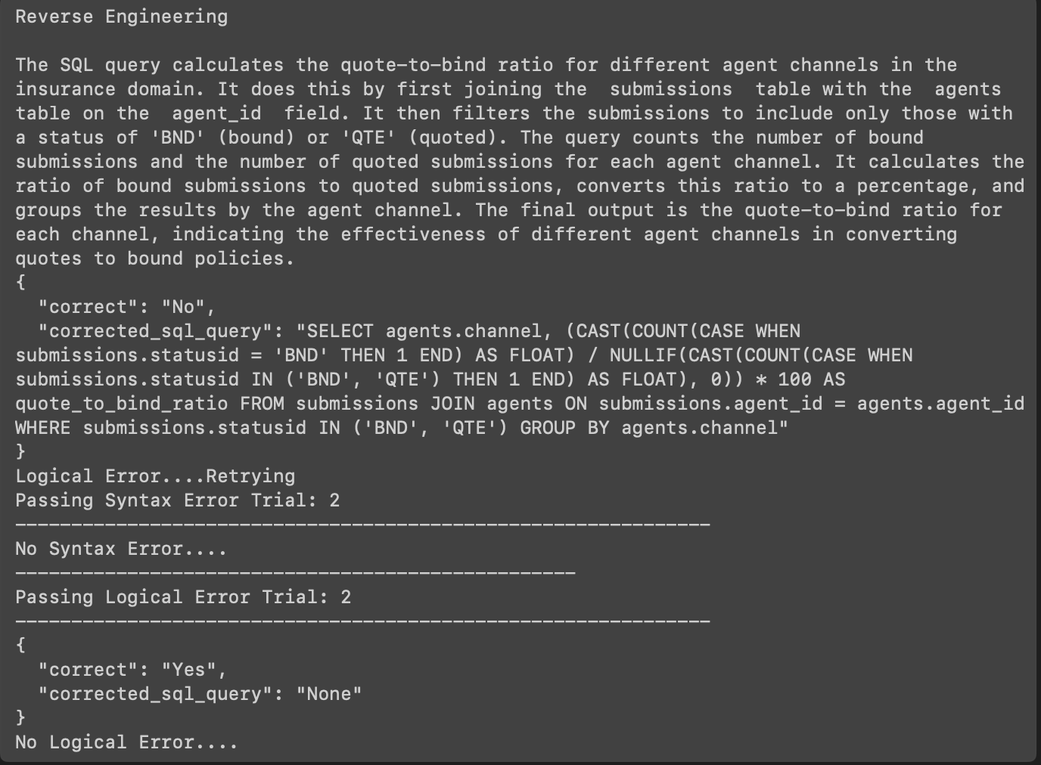
Reverse Engineering and Comparison with NL
Convert the generated query to NL again,
Use LLM-as-a-judge to compare the generated NL and NL query.

Slide 14
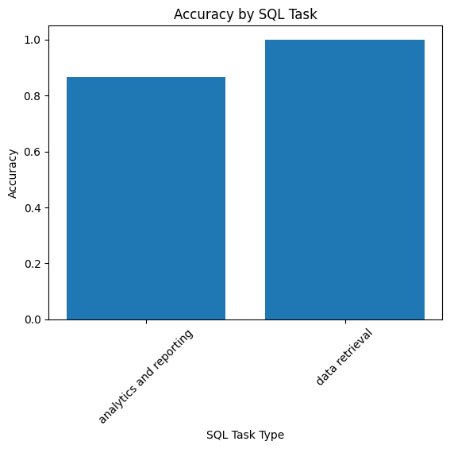
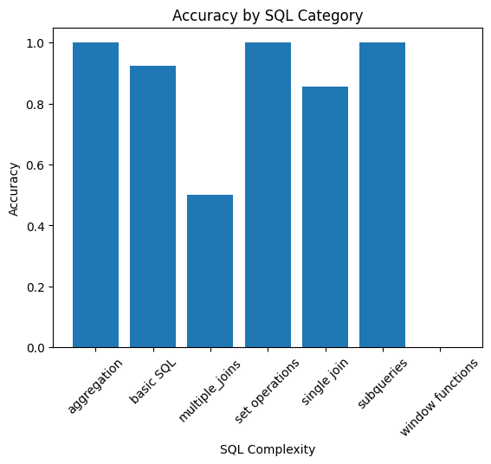
Evaluation and Results
Dataset used, from huggingface: gretelai/synthetic_text_to_sql, Tweaked the dataset a bit
LLM-as-a-Judge approach:
After a query is generated, it is compared against the ground truth and semantic link with the NL query
Reported Accuracy: 60 queries
50 dataset + 10 manual
~90%

Slide 15
Logistics
The execution has 7 LLM calls in total
Average time taken to fetch results: ~20s
LLM used: “mistral-large-2411”
Roles for LLMs:
Insurance Domain Specialist
SQL Data Analyst
Judge

Slide 16
References
[1911.04942] RAT-SQL: Relation-Aware Schema Encoding and Linking for Text-to-SQL Parsers
[2304.11556] Divide and Prompt: Chain of Thought Prompting for Text-to-SQL
Evaluating NL2SQL via SQL2NL
SQL-of-Thought: Multi-agentic Text-to-SQL with Guided Error Correction

Slide 17
Thank you

